Slide 1
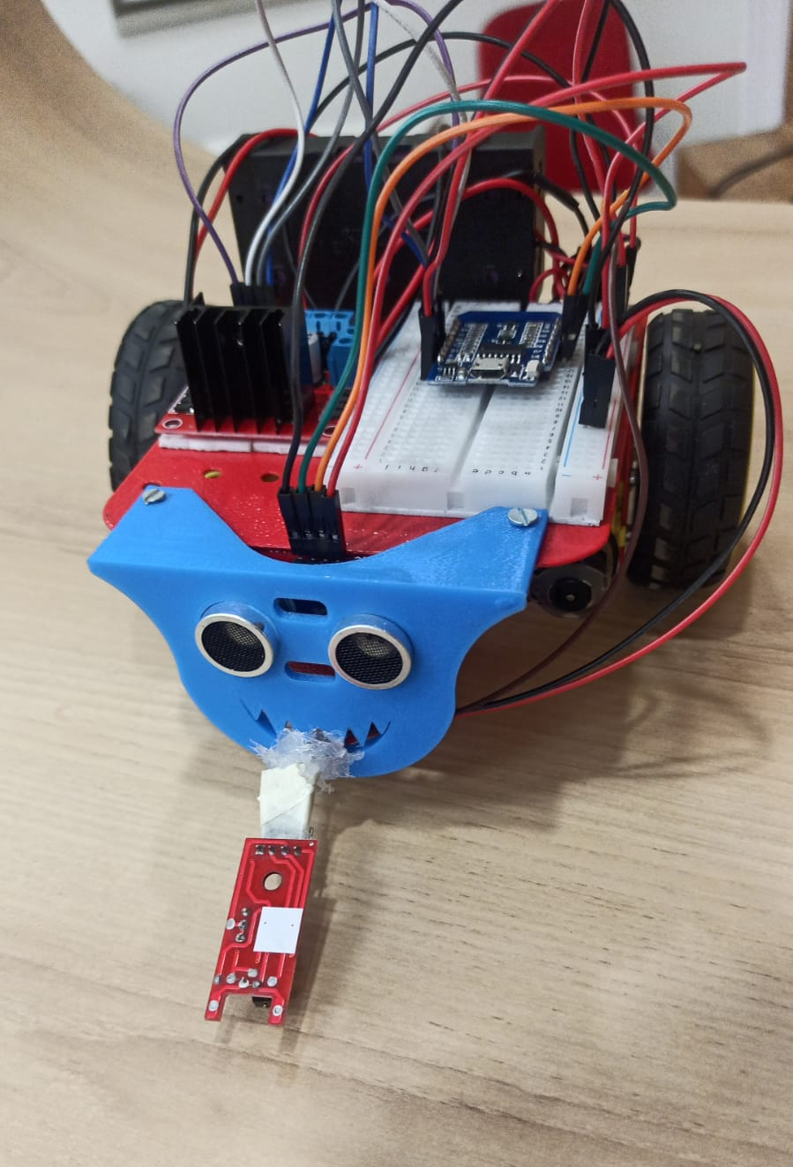
Automatic Landmine Detector
by Manan Sharma

Slide 2
My Introduction
Index
Problem
Solution
Components Involved
Code Logic
SDGs and Future Prospects

Slide 3
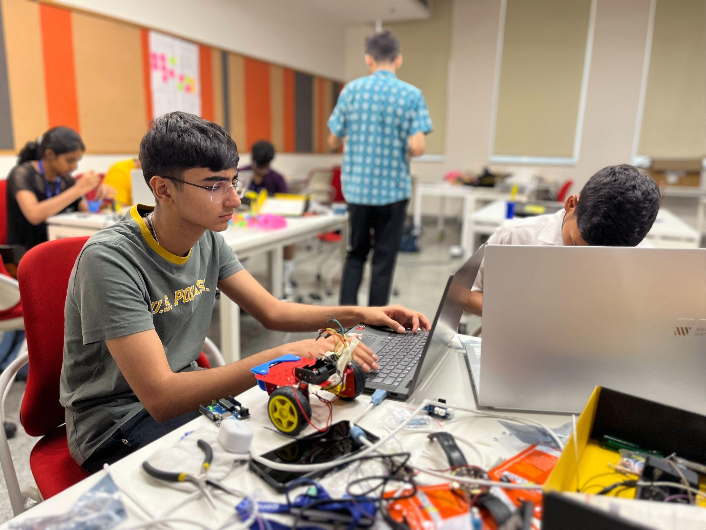
My Introduction
Manan Sharma
Some titles:
Inventor of the MineBot
AstroBott Founder | Defence Minister Commendation Card | YEB Entrepreneur | ISRO Young Scientist | Ex-President, Gavel Club of Aundh | 10 m Air Rifle Shooter | JVP Amateur Astronomer
Contact
manan.sharma@lgp_25.ashoka.edu.in

Slide 4

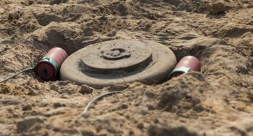
The problem
→ Undetectable landmines remain a serious hazard in post-war countries like Angola, Afghanistan, and Ukraine.
→ Civilians are at high risk, especially in rural and agricultural areas.
→ Manual detection is dangerous, slow, and costly, requiring trained personnel.
→ There is an urgent need for remote, low-cost, and automated mine detection systems.
?
!

Slide 5
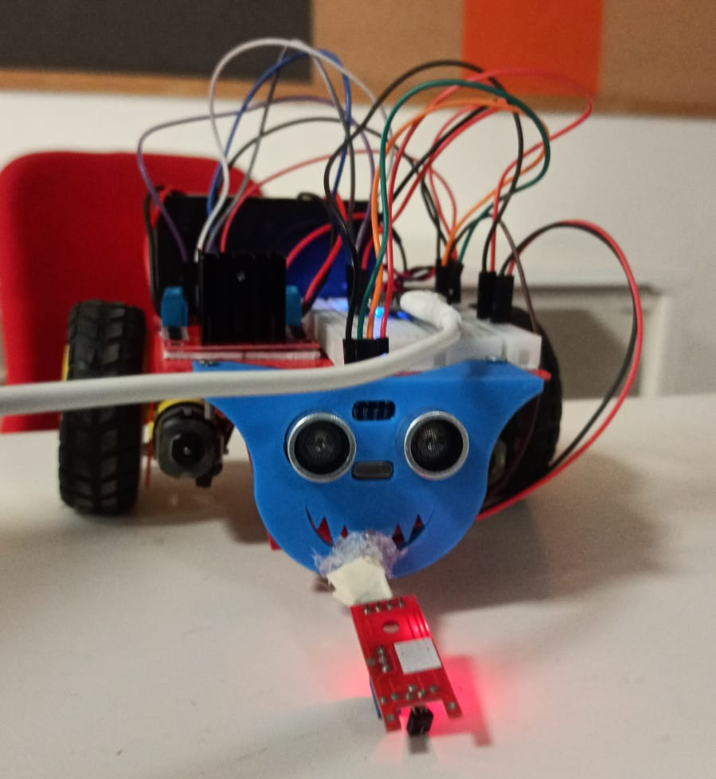
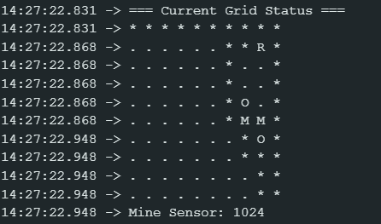
The solution
→A small autonomous rover detects and maps buried mines in a grid-based area.
→ It uses mine and ultrasonic sensors to identify mines and avoid obstacles.
→ The rover autonomously explores a 10x10 grid, marking detected mines.
→ A local Wi-Fi web server displays the mine map with red crosses on a black background.
→ This system enables safe, low-cost, remote mine detection with minimal human risk, because nothing is more important than human life.

Slide 6
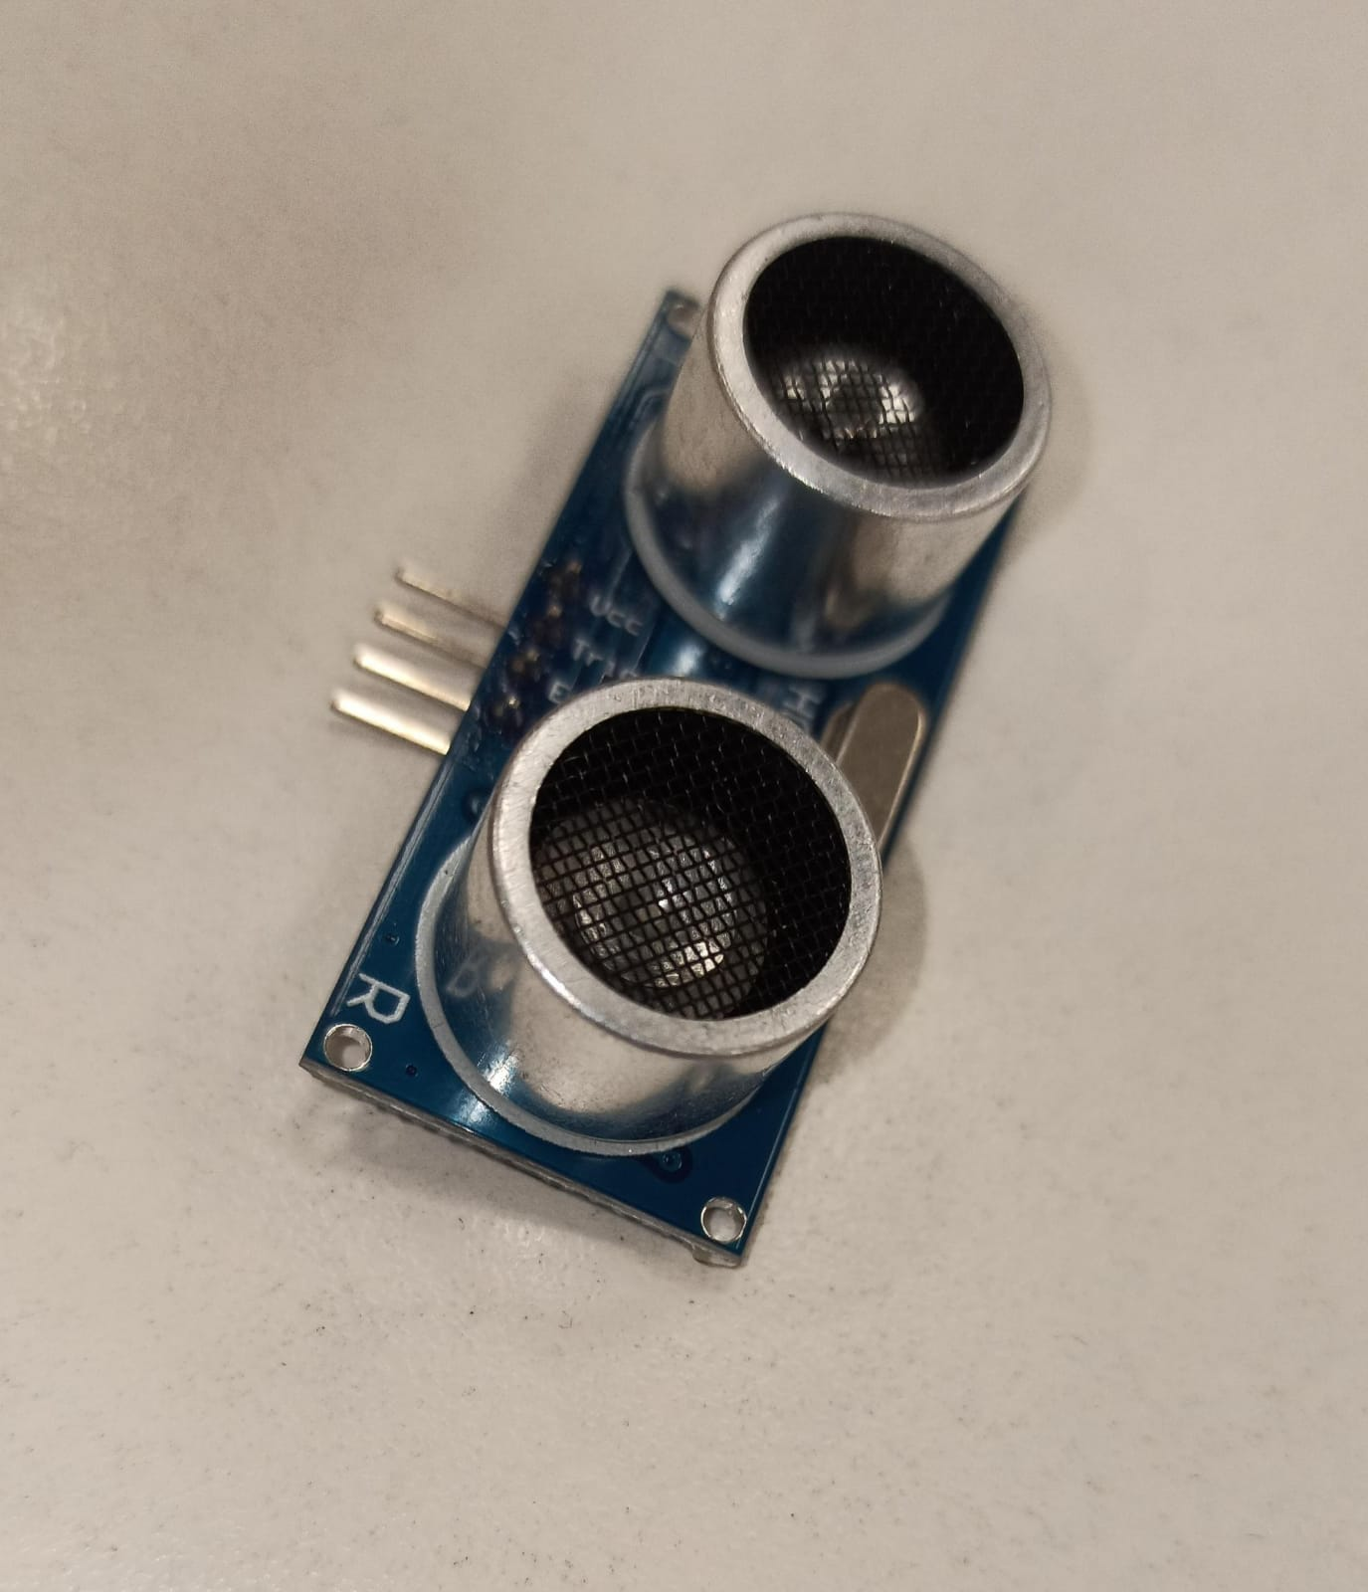
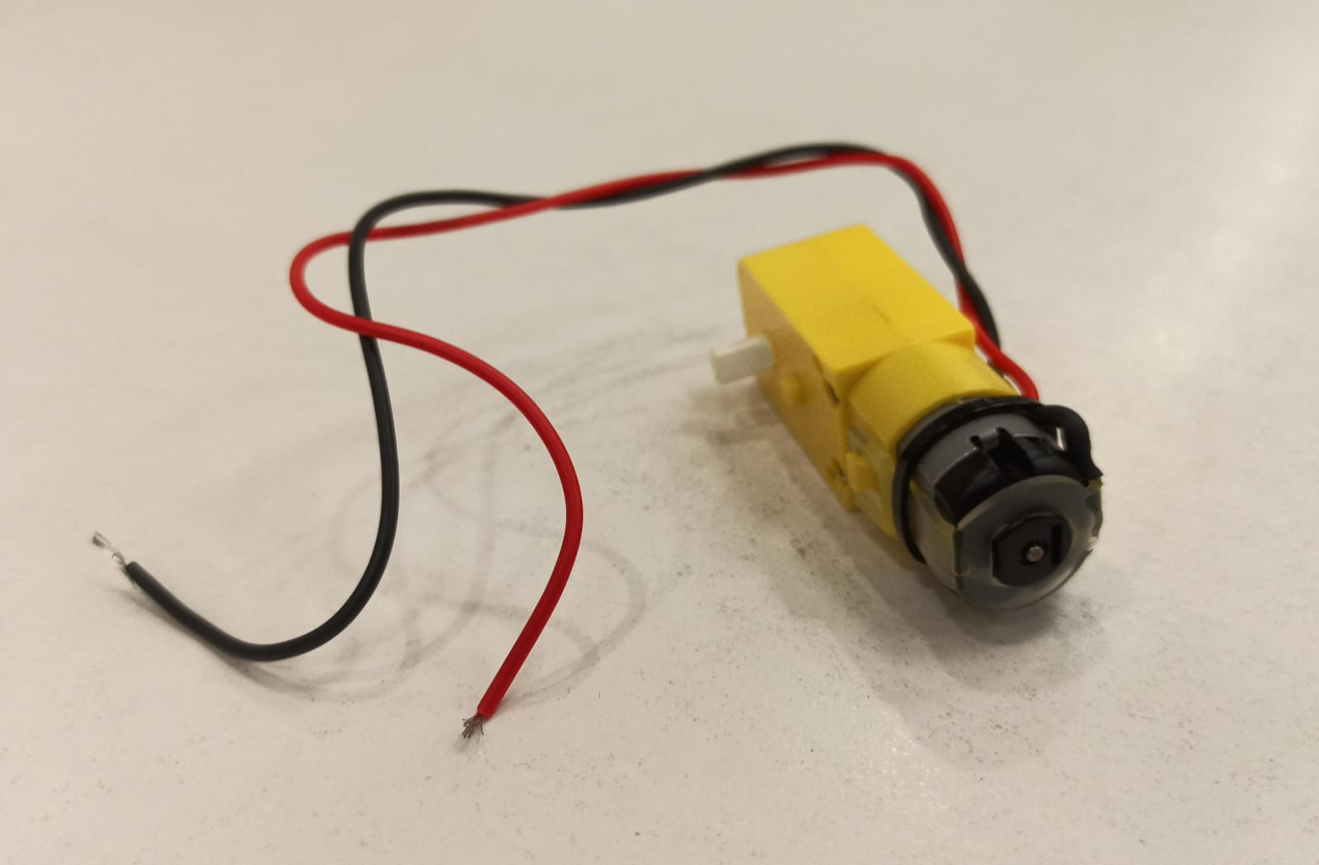
One Iteration of MineBot
Starts at Top-Right Corner(representative).
Initialization of variables and setup of the board.
Checks for obstacle/mine, if found, move using spiral movement.
Update grid and print in serial monitor.
Update to locally hosted website / app.
Notes:
This code controls a mine-detecting robot that:
Input: Reads mine sensor and obstacle sensor data as it moves
Process: Explores a 10x10 grid area systematically, like mowing a lawn
Output:
- Sends live map via Bluetooth showing mines (M), obstacles (O), and explored areas
- Returns to starting point when done
It can be thought of as a smart robot that methodically searches an area for buried mines while avoiding obstacles, then reports what it found on a map on a serial monitor.
You can view the flowchart in the next slide for better visual understanding.

Slide 7
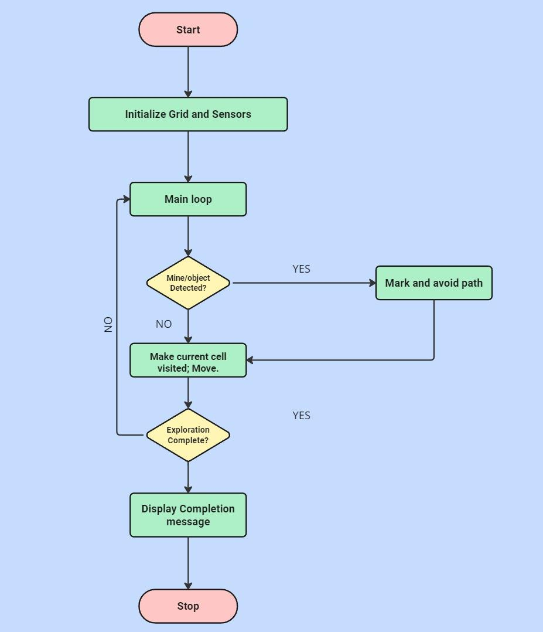
Flowchart

Slide 8
Components Involved
Component
Description
Cost(INR)
Total:₹750
WEMOS
Medium of communication; manages input/output as per code.
~150
Motor Driver
Voltage management and running the motors
~100
Batteries x2; Battery Holder
Power supply
~40 x2
Ultrasonic and Touch sensor
Detection of obstacle and mine respectively
~50 and ~100
BO Motors and Wheels
Locomotion
~70 x2
Chassis
Structural Integrity
~150

Slide 9


SDGs and Future Prospects
Upgrade the grid to website; improve aesthetics.
Space optimization.
Abstraction of hardware and open wiring.
Potential for usage in agriculture for mapping crop health across farms.

Slide 10
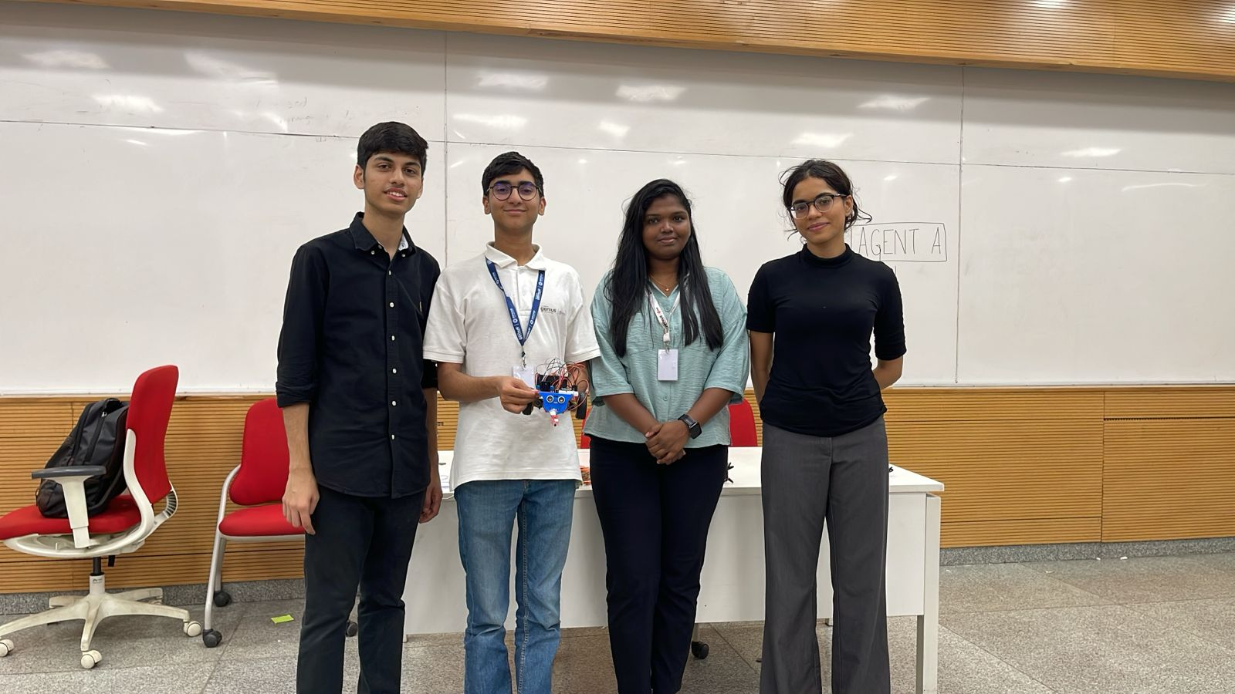
Citations and more:
Flowchart - miro.com
AI - Perplexity and Claude
Enormous Thanks to Professor Anita Kharat and TAs, Amay and Sampurna!

Slide 11
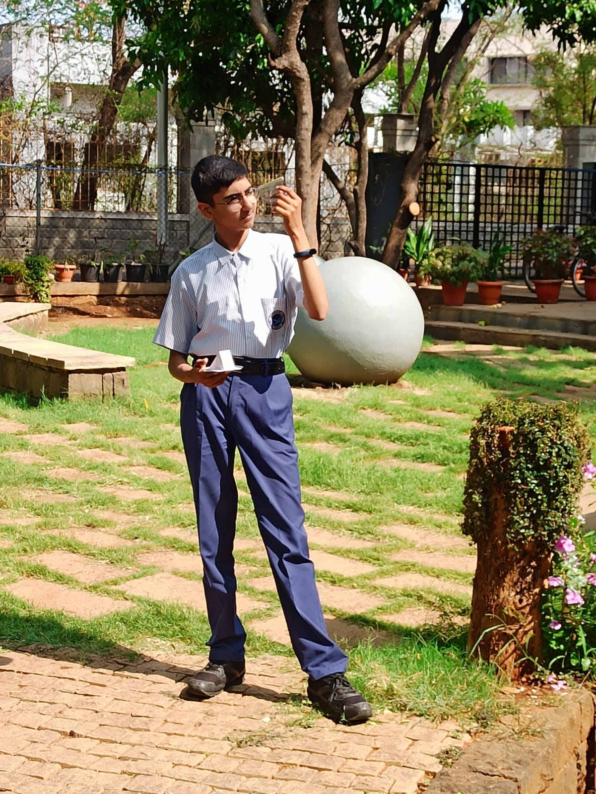
MANAN SHARMA
Thank you
Feedback?
manan.sharma@lgp_25.ashoka.edu.in
+91 93706 73504

